Slide 1
Pregel: A System for Large-Scale Graph Processing
Grzegorz Malewicz, Matthew H. Austern, Aart J. C. Bik, James C. Dehnert, Ilan Horn, Naty Leiser, and Grzegorz Czajkowski
Google Inc.
Presented by Daniel McCormick

Slide 2
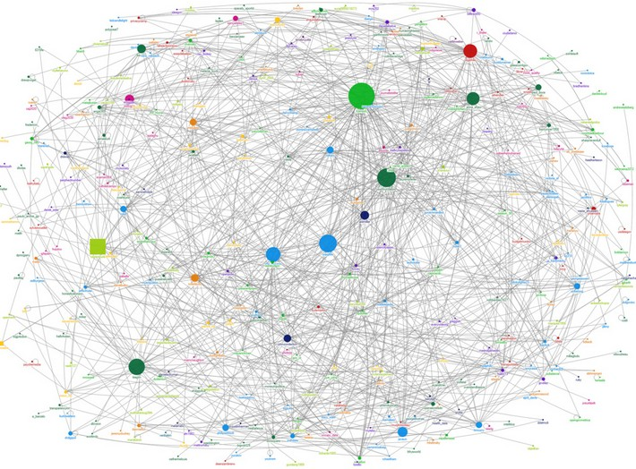
Motivation
Huge graphs very common
Existing options didn’t meet needs
“a scalable and fault-tolerant platform with an API that is suﬃciently ﬂexible to express arbitrary graph algorithms”
Notes:
Huge graphs very common
All sorts of examples – web crawls, Facebook Friends, etc… (basically any big data that can be expressed as a graph)
Existing options didn’t meet needs
4 existing options
Create a custom infrastructure for every graph problem – effective but costly, lots of work
Rely on existing platforms – again, can be effective, but a pain. Writing graph algorithms in MapReduce sucks.
Poor locality of memory in most graph algorithms means lots of data is going to need to be passed around in a MapReduce model (and most other models) – Don’t want to pass whole graph around at every step
Changing degree of parallelism throughout most algorithms – means platform needs to be able to handle highly parallel situations as well as non-parallel situations
Single computer algorithm library – good for small data, doesn’t scale
Existing parallel graph systems – good for the most part, but not fault tolerant. If a node fails, has to start over – really bad for huge systems where failure is common
“a scalable and fault-tolerant platform with an API that is suﬃciently ﬂexible to express arbitrary graph algorithms”

Slide 3
Overview (from user’s perspective)
Assumes a directed graph
Series of iterations, called supersteps
At each step, the framework invokes a user-defined function on every vertex, conceptually in parallel
“Think like a node”
Notes:
Supersteps
Iterative model essentially breaks down algorithm into sequence of iterations, at each operation every vertex is processed conceptually in parallel
Eliminates deadlock and data races because each vertex has access only to their own data (including received messages) for each operation, parallel operations will never try to access the same data
Iterative algorithms are very common and often as efficient as those run asynchronously (with access to all of the graphs data at any time)
“Think like a node”
Work is done from each node’s perspective rather than operating on the whole graph at once
Vertices are first-class citizens, edges are not in this model. No computation is associated with edges

Slide 4
Supersteps
At each superstep, a user defined function is invoked on every node
A vertex can perform 3 different operations
Send messages to other vertices
Read messages sent to it in the previous superstep
Modify it’s own state

Slide 5
Messaging
Messages sent at superstep n-1 will be received at superstep n
Nodes can send messages to any node using it’s vertex identifier
Most often sent along outgoing edges
No guarantee on order of messages
Guaranteed delivery without duplicates

Slide 6

Termination
When a vertex is done with its work, it can deactivate itself
Can be reactivated by a message if necessary
When all vertices have deactivated themselves and no messages are in transit, the whole algorithm terminates
Output of graph is the set of values explicitly output by the vertices
Notes:
Output of graph
Could be whole graph, could just be a subset when appropriate

Slide 7
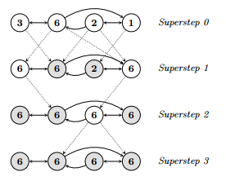
Max Value Algorithm Example
Notes:
Shaded vertices have voted to halt
Vertices send messages on all outgoing edges telling their values
If vertex isn’t updated it halts

Slide 8

API
User overrides Compute() function
Inside Compute(), can get value of vertex, mutate the value, and send or receive messages
Compute() can also add or remove vertices or edges
Vertices and edges added lazily
Notes:
Passing messages
Often done just to vertices that sender has edges to
Can be sent to any vertex, regardless of edge
User defined handlers define behavior when destination vertex doesn’t exist

Slide 9
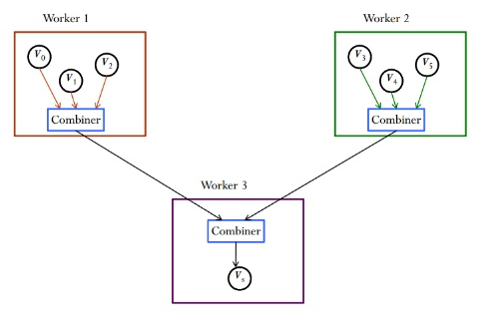
Combiners
Can be written for incoming and outgoing messages
Combine multiple messages into 1 message
Reduces network requirements and minimizes space requirements
Notes:
Must be user defined

Slide 10
Aggregators
Used to get data about whole graph
Some aggregators are already provided (e.g. max, min)
Additional ones can be defined by the user
Most aggregators are just for a given superstep, can be overridden to aggregate over all supersteps
Called a sticky aggregator

Slide 11
Handling Conflicts
When adding/removing vertices, conflicts can arise if 2 vertices try to mutate the same vertex (e.g. initialize vertex V with different values)
2 main ways of dealing with conflict
Vertices are removed before added
User can define additional handlers as needed, otherwise it is randomized
Notes:
Mutations of topology occur in the superstep after request issued
Vertices are removed before added – partial ordering yields deterministic results for most conflicts

Slide 12
Handling Edge Conflicts
Edge conflicts will never occur so no mechanism necessary
Each vertex controls its own outgoing edges, so there can be no contention

Slide 13

Input and Output
Decoupled from graph computation
User defines how to take in input and produce output

Slide 14

Implementation
Designed to run on Google Cluster
Clusters of commodity hardware distributed geographically
Schedules jobs to optimize resource allocation
Persistent data stored as files in distributed storage systems
Notes:
Designed to run on Google cluster
Has to be able to deal with faults
Optimize resource allocation
Sometimes instances are killed and moved to better balance loads
Persistent data stored in distributed systems
E.g. GFS or Bigtable

Slide 15
Basic Architecture
One master node, many worker nodes
Master in charge of synchronizing supersteps
Master coordinates between machines to determine when all vertices are done
Notes:
One master
Not responsible for any portion of the graph
Synchronizing supersteps
Master tells workers when to start next superstep
When workers are done, they reply with their number of active vertices
When all vertices are done
Master tells vertices what to save (if anything) on top of explicit output

Slide 16
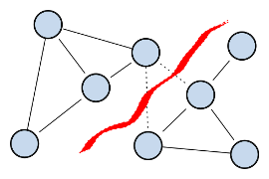
Partitioning
Graph partitioned by vertex id (using hashing)
Master assigns partitions to workers
Usually each worker has multiple partitions
Master then assigns user input to machines based off of partitions
Notes:
Graph partitioned
Automatically done by system, can also be user defined
Master assigns partitions
Giving multiple partitions per worker increases parallelism
User can custom define partitions if helpful

Slide 17

Fault Tolerance
At start of a checkpoint superstep, workers save their state to persistent storage
Master does same with aggregator values
Worker failure detected by consistent pings
If worker doesn’t receive a ping in a while, it terminates
If master doesn’t receive response in a while, the worker has failed
Notes:
Checkpoint superstep – chosen based on mean time to failure model
Saving state to persistent storage
State = vertex values, edge values, and incoming messages
Worker failure detection
Difference between slow response and failure? There is none

Slide 18

Recovery
On worker failure, master redistributes load
Progress is recovered up to checkpoint
Confined recovery – outgoing messages logged so that only failed part has to recover
Still in development
Only works with deterministic algorithms
Notes:
Progress recovered up to checkpoint
Last saved superstep, could be several steps behind
Confined recovery
Must be deterministic. If random, could get conflicting states (e.g. first time around it sent a different message than 2nd time)

Slide 19
Worker Implementation
Maintains state of partitions in memory
Messages from one machine to another are put in a buffer and asynchronously sent in batches (when buffer full)
Local messages put directly in receiving queue
Reading from remote is slow, amortizes latency by asynchronously delivering in batches
Combiners applied when messages are put on outgoing queue and when they are received/put on incoming queue
Notes:
Maintains state of partitions
State includes a map to each vertex, which in turn includes the current value, a list of outgoing edges, a queue of incoming messages, and a flag indicating if the vertex is active
2 copies of vertex flags and message queue exist: one for current superstep, one for next superstep
Asynchronous batch delivery
Speeds up processing because don’t have to wait for reply and batches are better because they can be combined into smaller messages (or using combiners into a single message)

Slide 20
Master Implementation
Master maintains locations of all partitions
Maintains statistics about progress of computations and state of graph
Aggregators done locally (not by master) and chained together to Master
Uses barrier synchronization for all of its operations
Notes:
Barrier synchronization – waits until workers respond
Aggregators – chained as a tree (e.g. 2 workers combine results, then combine those results with results of 2 more workers, etc… until only one result remaining)
Sent to workers at start of each superstep

Slide 21
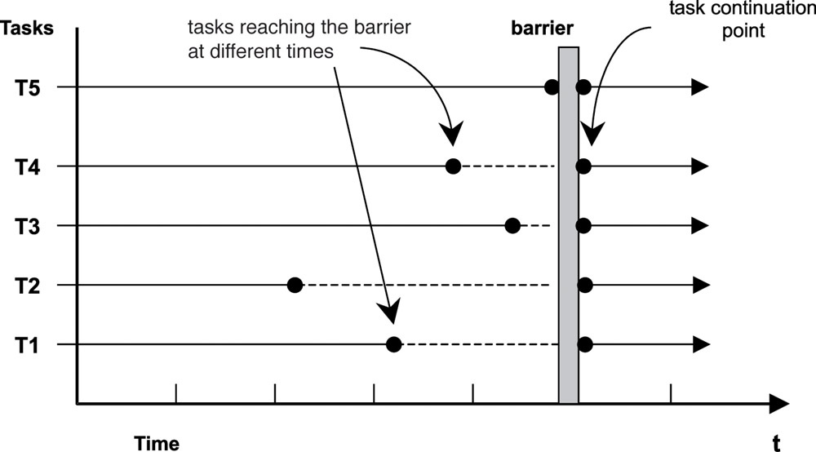
Barrier Synchronization
Waits for all tasks to reach barrier point (aka respond to master) before allowing any to proceed

Slide 22
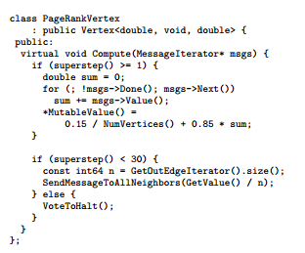
PageRank
Assume graph is initialized with each vertex valued at 1/NumVertices()
At each step: each vertex sends its tentative PageRank along outgoing edges
Calculates new PageRank by summing incoming PageRanks, calculating 0.15/NumVertices() + 0.85 × sum
Notes:
In practice, would be run to convergence in this example only run for 30 iterations
Written in a MapReduce platform would be much less efficient
Would probably send websites (and maybe links as well) as keys, PageRanks as values, all the info has to be moved around a ton (though combiners could help)
PageRank only requires sending messages consisting of the vertexID and the PageRank, much lighter weight
ASK: How could you partition websites onto worker nodes?
ANSWER: Want to maximize locality, so group sites that you know have links (or edges) to each other. For example, you might want to group news sites because they often link to each other
Minimizes number of messages that need to be sent

Slide 23
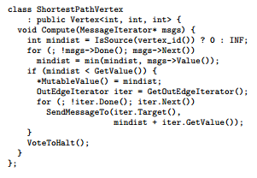
Single Source Shortest Path
Find lowest weight path from s to t
Initialize every vertex to INF (basically infinity)
At first step, source vertex given value of 0
Notes:
Basically just a breadth first algorithm

Slide 24
Single Source Shortest Path
At every step, each vertex checks its incoming message to see if it contains a path with a smaller value than its current value
If yes, then it updates its current value to that new value
Then sends messages along its outgoing edges with its current value + the weight of that edge

Slide 25
Single Source Shortest Path
Each vertex votes to halt when it doesn’t receive a message
When no messages are sent, entire algorithm will halt

Slide 26
Single Source Shortest Path
11
INF
10
3
0
1
INF
1
2
Shaded boxes have voted to halt
INF
INF

Slide 27
Single Source Shortest Path
11
10
10
3
0
1
11
1
2
Shaded boxes have voted to halt
1
INF

Slide 28
Single Source Shortest Path
11
10
10
3
0
1
11
1
2
Shaded boxes have voted to halt
1
3

Slide 29
Single Source Shortest Path
11
4
10
3
0
1
11
1
2
Shaded boxes have voted to halt
1
3

Slide 30
Single Source Shortest Path
11
4
10
3
0
1
7
1
2
Shaded boxes have voted to halt
1
3

Slide 31
Single Source Shortest Path
11
4
10
3
0
1
7
1
2
Shaded boxes have voted to halt
1
3
Notes:
ASK: How could this algorithm be written in MR?
Answer: Would have to keep track of vertexID’s and their current shortest path as key pair to be reduced to single vertexID/shortest path in the reduce stage
Would require at least one key/pair per vertex each time
Requires passing significantly more data than Pregel

Slide 32
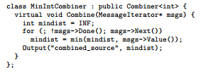
Possible Combiner
Takes minimum of all local messages for a given vertex, sends that instead of all of them

Slide 33
Performance
Tested using shortest path algorithm
Linear speedup – 10x speedup with 16x as many machines
Runtime scales linearly with the number of vertices

Slide 34
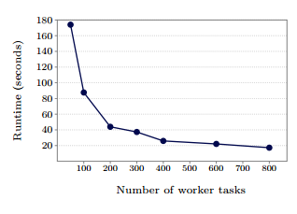
As worker tasks are added, runtime goes down significantly for vertices with low average outdegree (16x machines = 10x speed)
Notes:
Shortest path algorithm run on 1 billion vertex binary search tree. Assumes edge weight of 1 – obviously not typical input, shows scalability

Slide 35
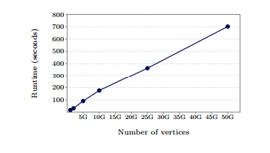
Runtime increases linearly with graph size for graphs with low average outdegree (50x vertices = 41x time)
Notes:
Again, run on binary tree to show scalablity

Slide 36
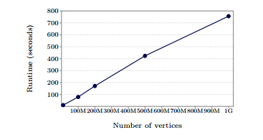
Runtime increases linearly with graph size for graphs with more typical average outdegree (100x vertices = 92x time)
Notes:
Basically randomly generated graph with a much more dense number of vertices
Still linear scaleup

Slide 37
Performance drawbacks
Algorithm must be efficiently parallelizable to achieve benefits
Performance suffers on graphs that send tons of messages
Barrier synchronization can keep workers waiting for longer than necessary
All computation resides in RAM, not good if there isn’t enough space for partitions
Notes:
Must be efficiently parallelizable – Most algorithms must be modified to take advantage of the benefits of parallelization, easier for some algorithms than others
Graphs that send tons of messages
Aka graphs where vertices tend to send messages to all/most other vertices, usually very dense graphs
Such graphs are pretty rare in practice (for example, if you’re dealing with indexing the web, most vertices (pages) won’t have links to that many other vertices)
Barrier synchronization – bad if there are stragglers – asynchronous model in the works

Slide 38
Conclusion
Succeeded at goal of being “a scalable and fault-tolerant platform with an API that is suﬃciently ﬂexible to express arbitrary graph algorithms”
Struggles with dense graphs that sends lots of messages

Slide 39
Picture credit
http://beyondplm.com/2013/08/23/why-graph-analyzes-will-rule-plm-in-the-future/
https://www.iconfinder.com/icons/200993/e-mail_letter_mail_message_sending_subscribe_suport_icon
https://www.mountaingoatsoftware.com/blog/making-the-decision-to-abnormally-terminate-a-sprint
https://wiki.engr.illinois.edu/download/attachments/188588798/pregel.pdf?version=1
https://www.123rf.com/photo_3804727_red-green-in-out-sign-isolated-on-white-background.html
https://www.google.com/intl/ALL_ie/doodle4google/
http://www.ml.uni-saarland.de/code/oneSpectralClustering/oneSpectralClustering.htm
http://www.fakeposters.com/posters/failure-dog/
http://www.embeddedlinux.org.cn/rtconforembsys/5107final/LiB0091.html

